Slide 1

Twilight People – The Exhibition
#Tpexhibition #TPpopup
Photography: Christa Holka
@ Twilight People
- All rights reserved -

Slide 2
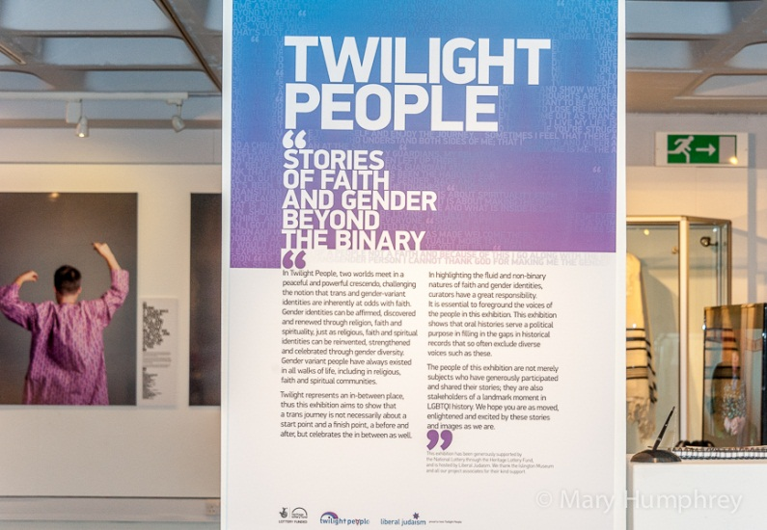
Launched at Islington Museum for LGBT History Month 2016

Slide 3
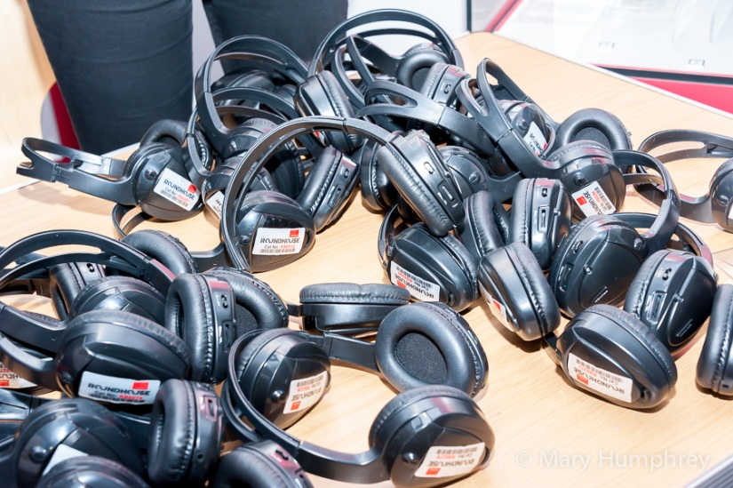
Watch and Listen:
https://www.mixcloud.com/roundhouseradio/twilight-people-4-february-2016/
Audio Installation
Produced in collaboration with Roundhouse & Soas Radio and Gendered Intelligence

Slide 4
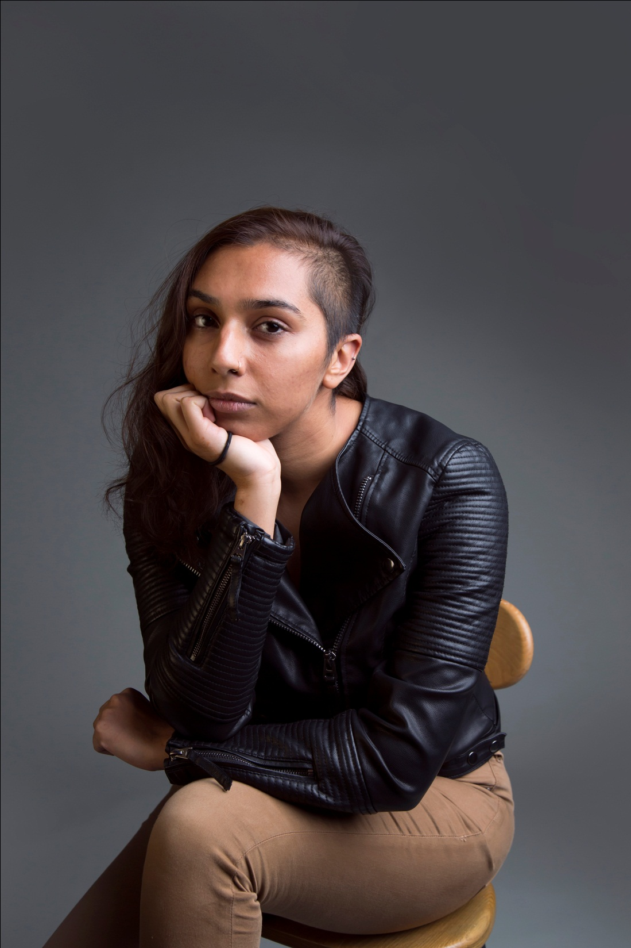
Umber

Slide 5
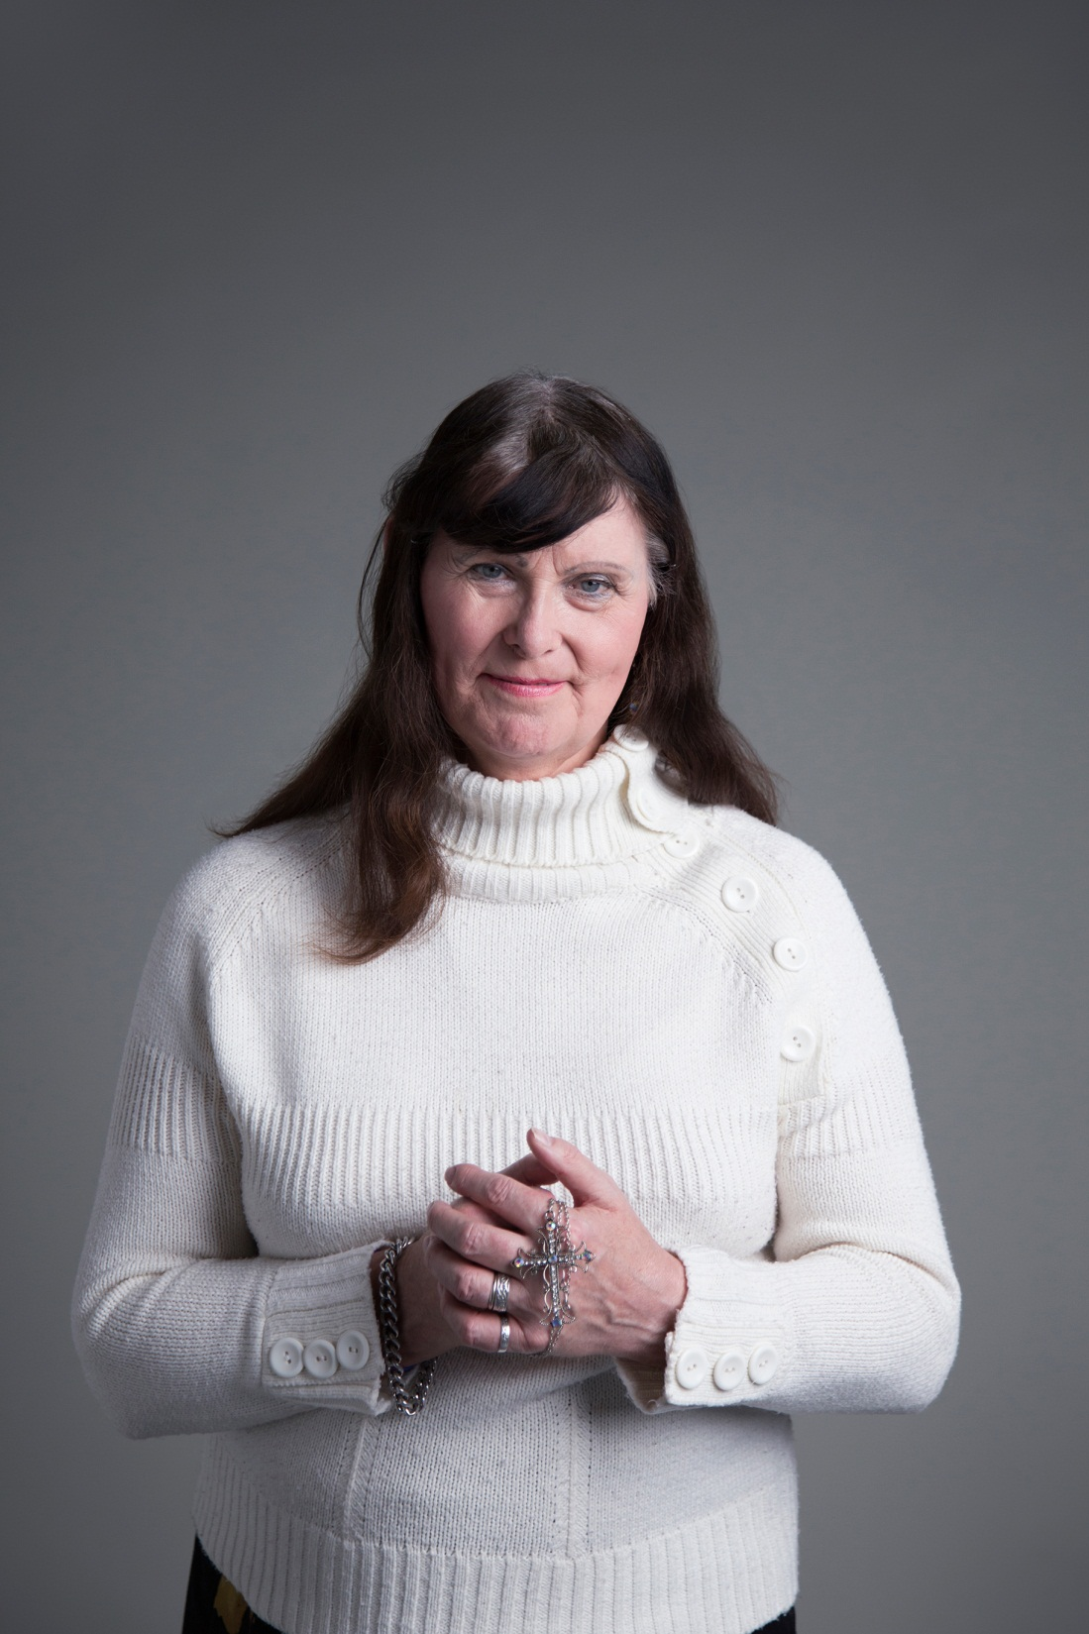
Jenny-Anne OBE

Slide 6
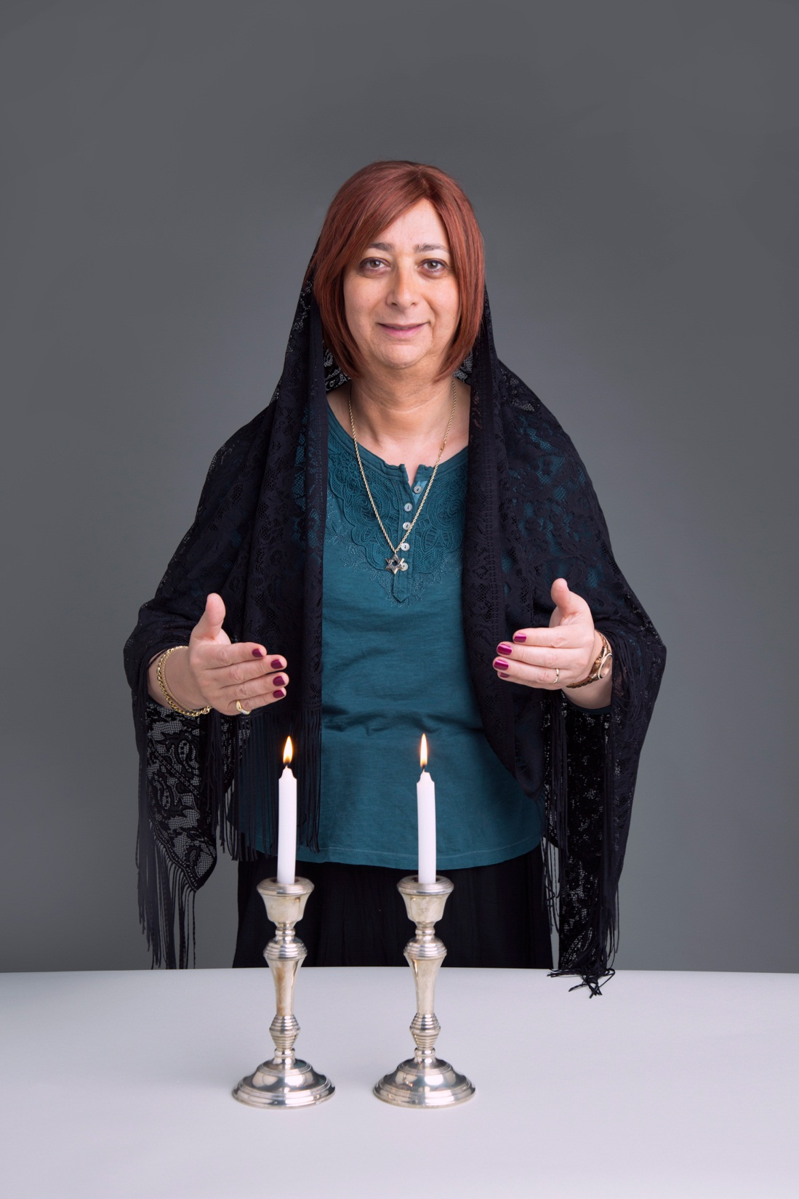
Isabella

Slide 7

CJ

Slide 8
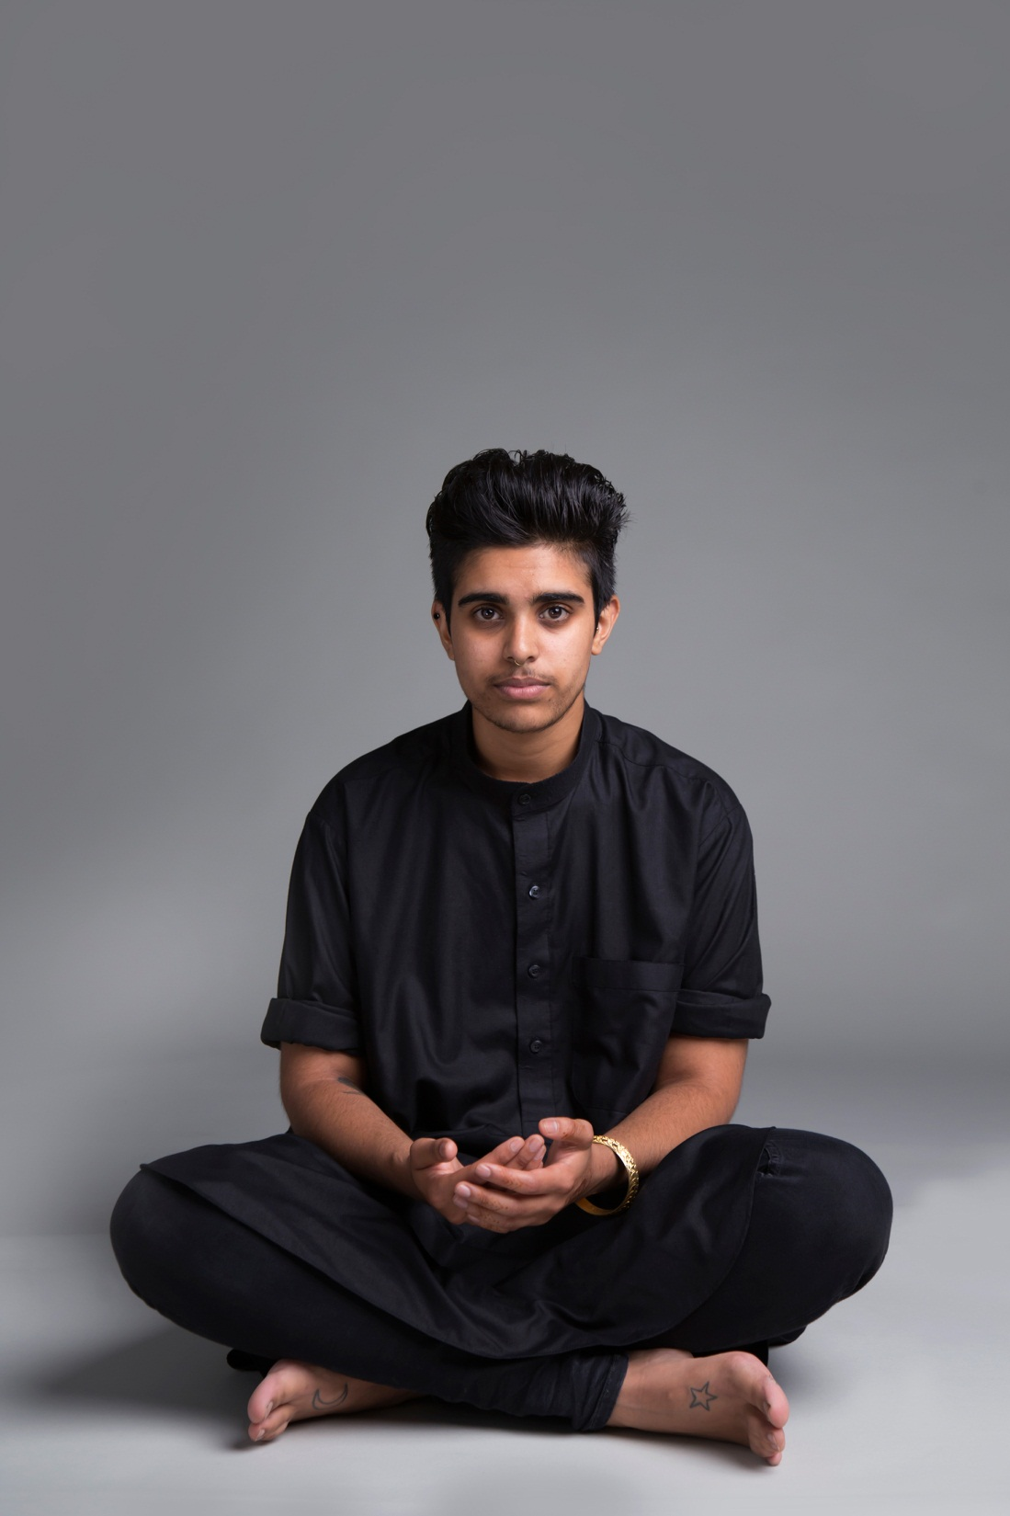
Sabah

Slide 9
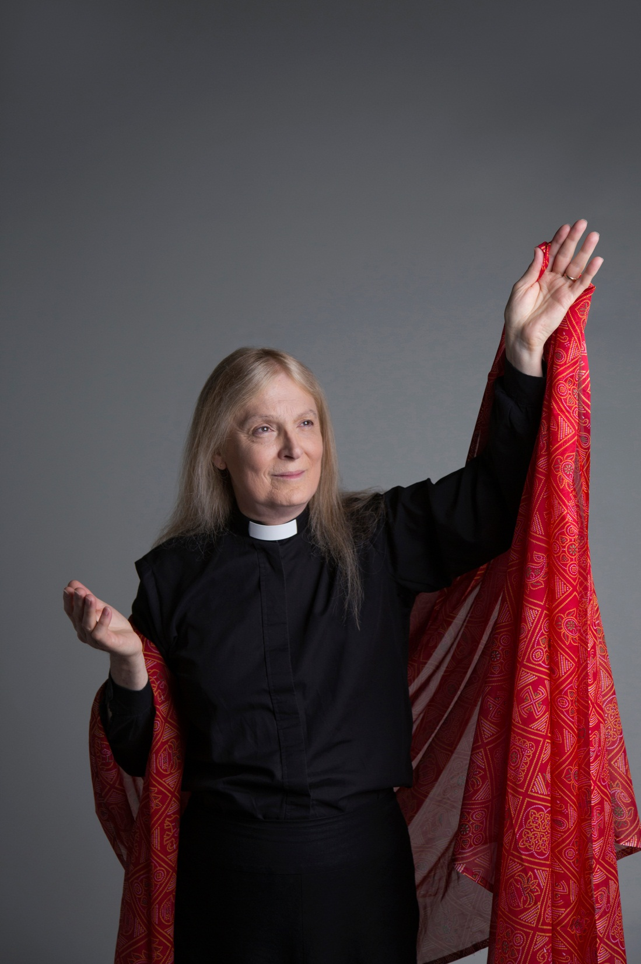
Christina , Revd

Slide 10
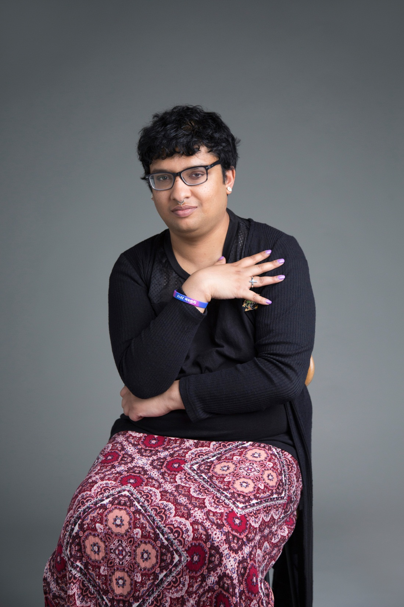
Kiku Aruba

Slide 11
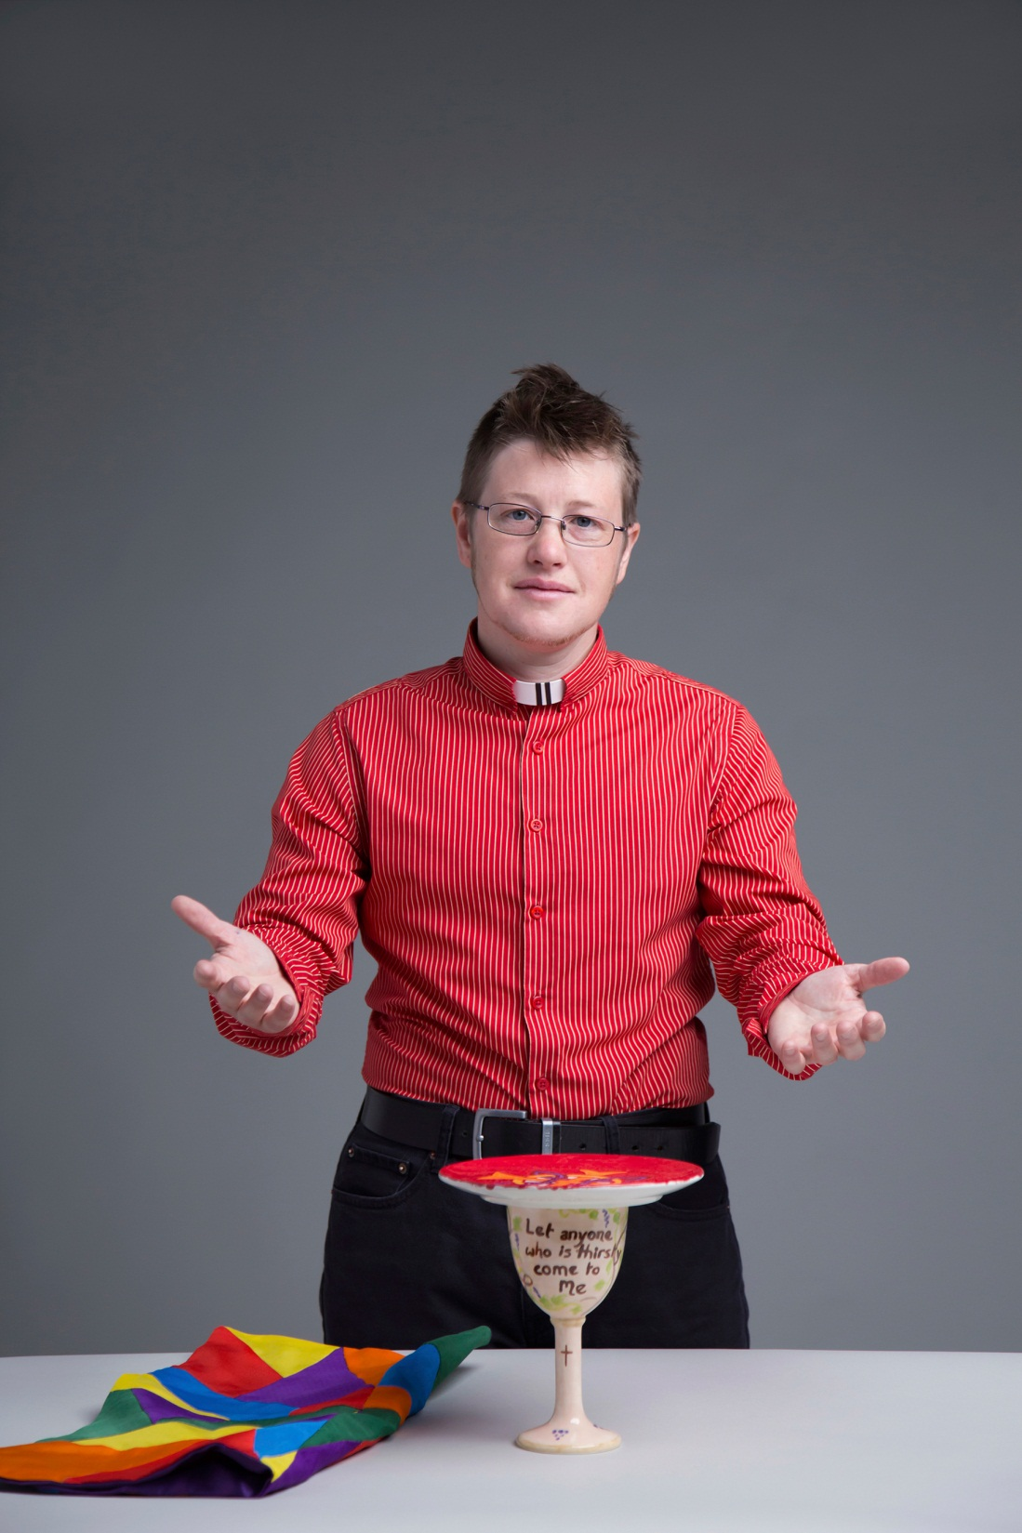
Peta

Slide 12
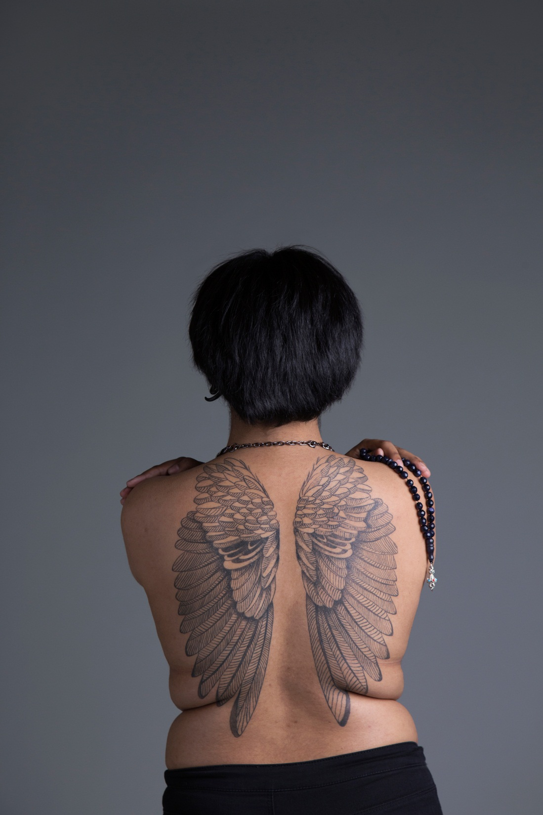
Anon

Slide 13
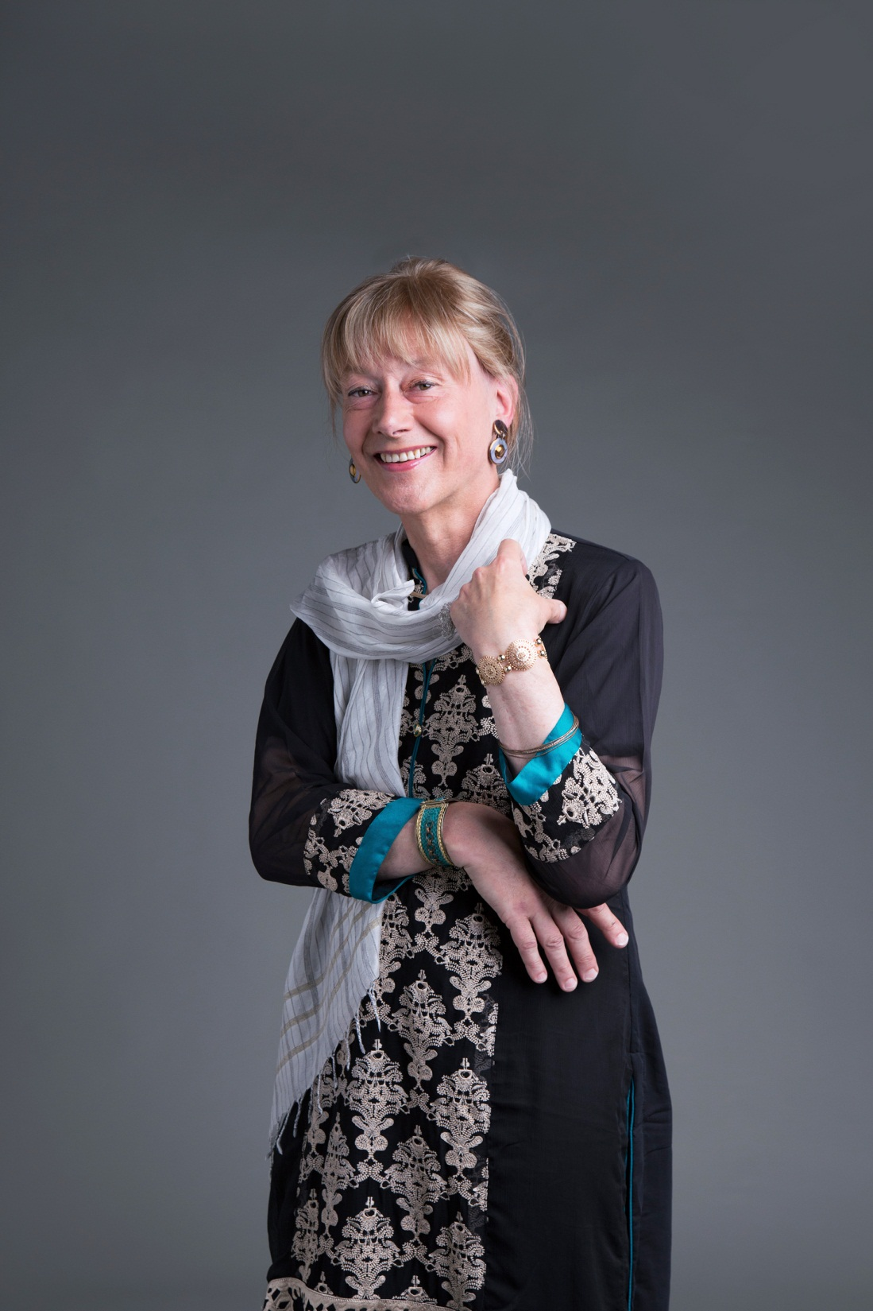
Vida

Slide 14
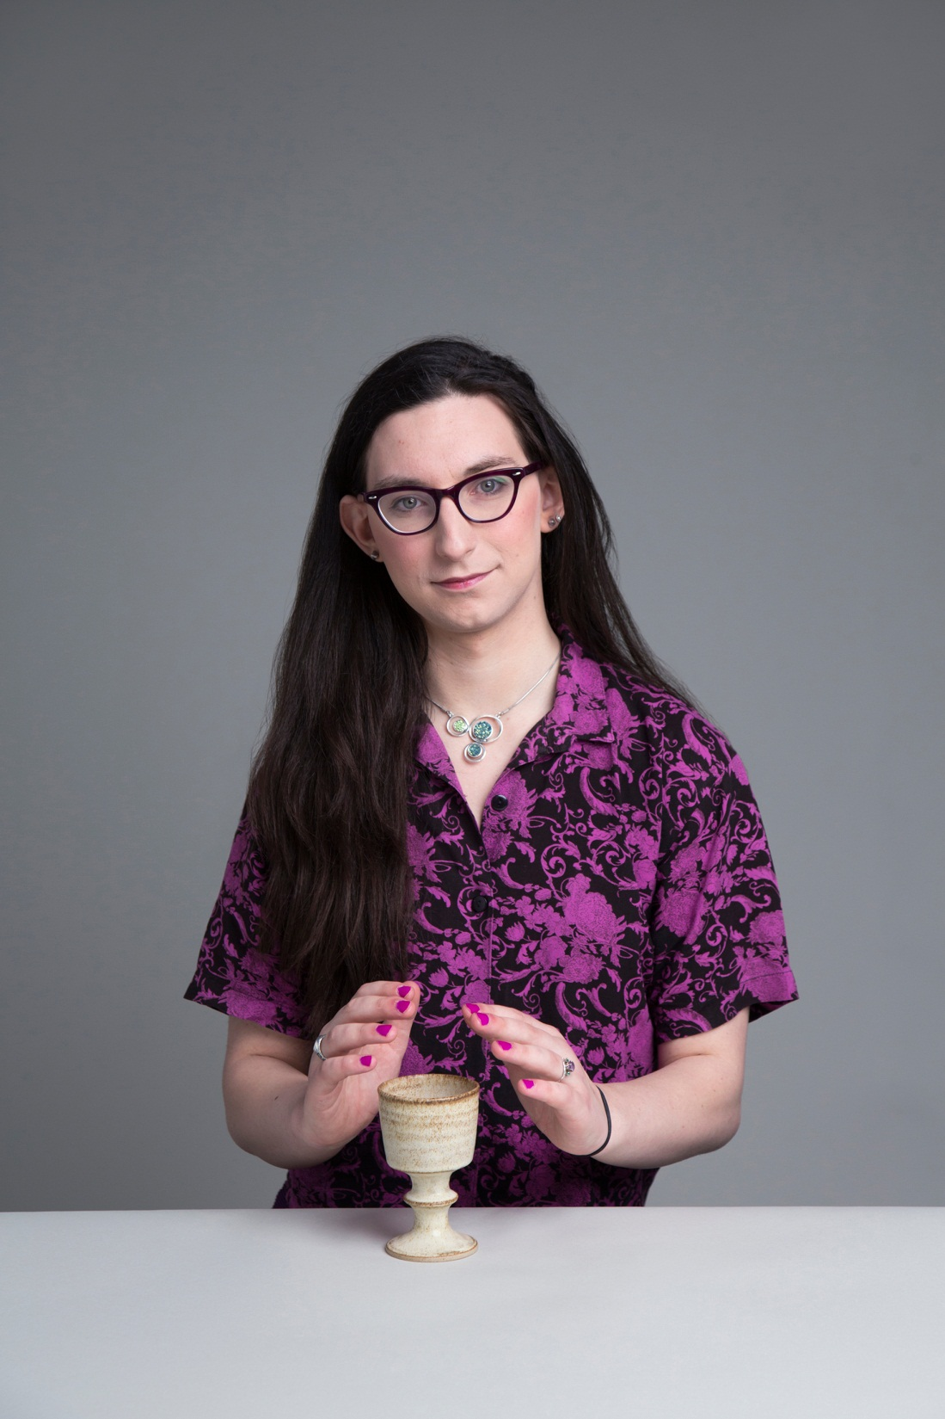
Reubs

Slide 15
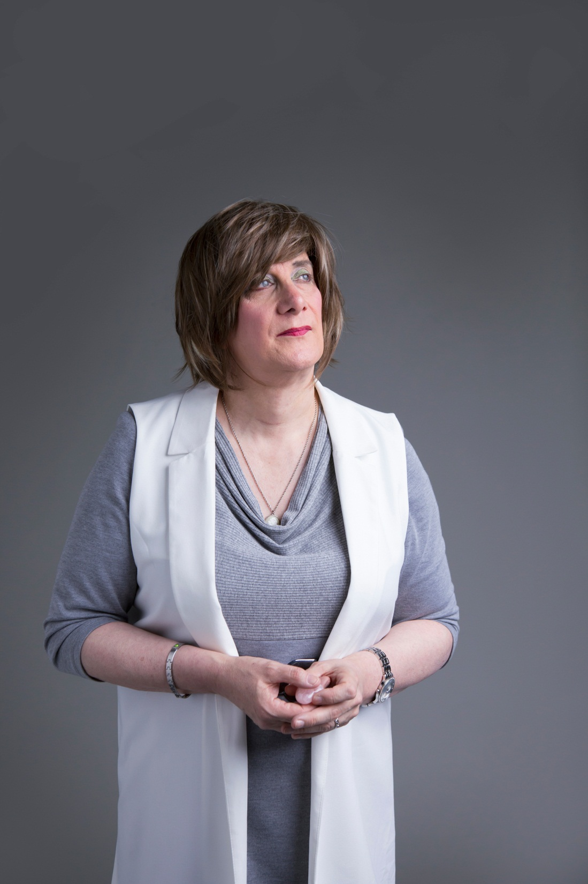
Abi

Slide 16
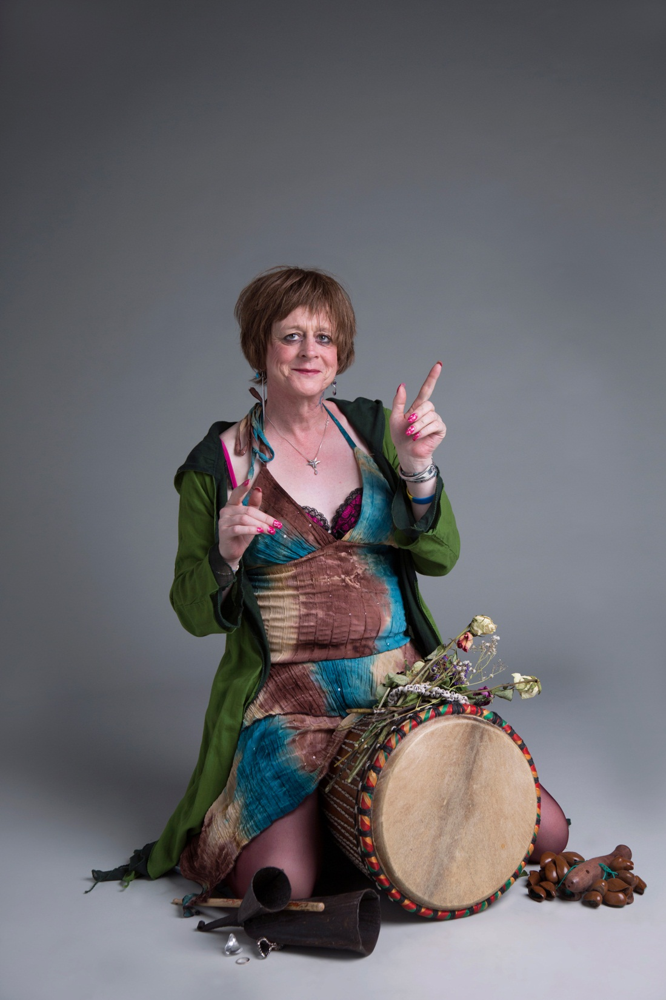
Harmonie

Slide 17
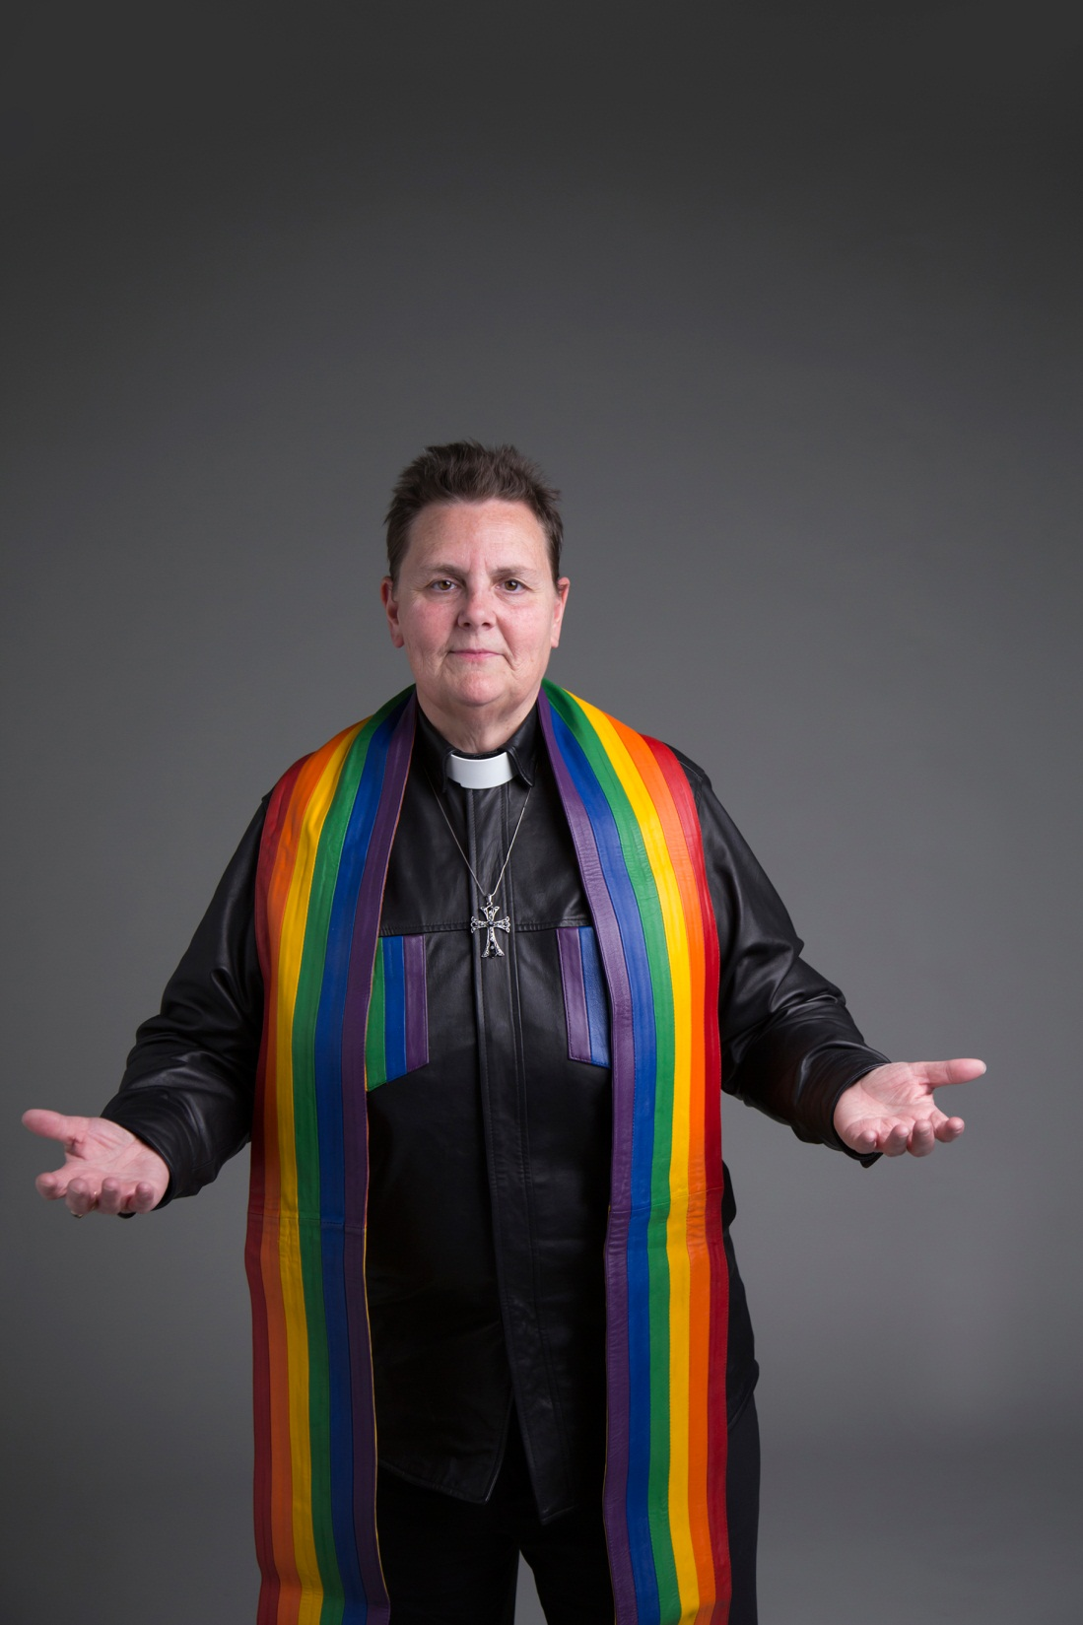
Shanon, Rev

Slide 18
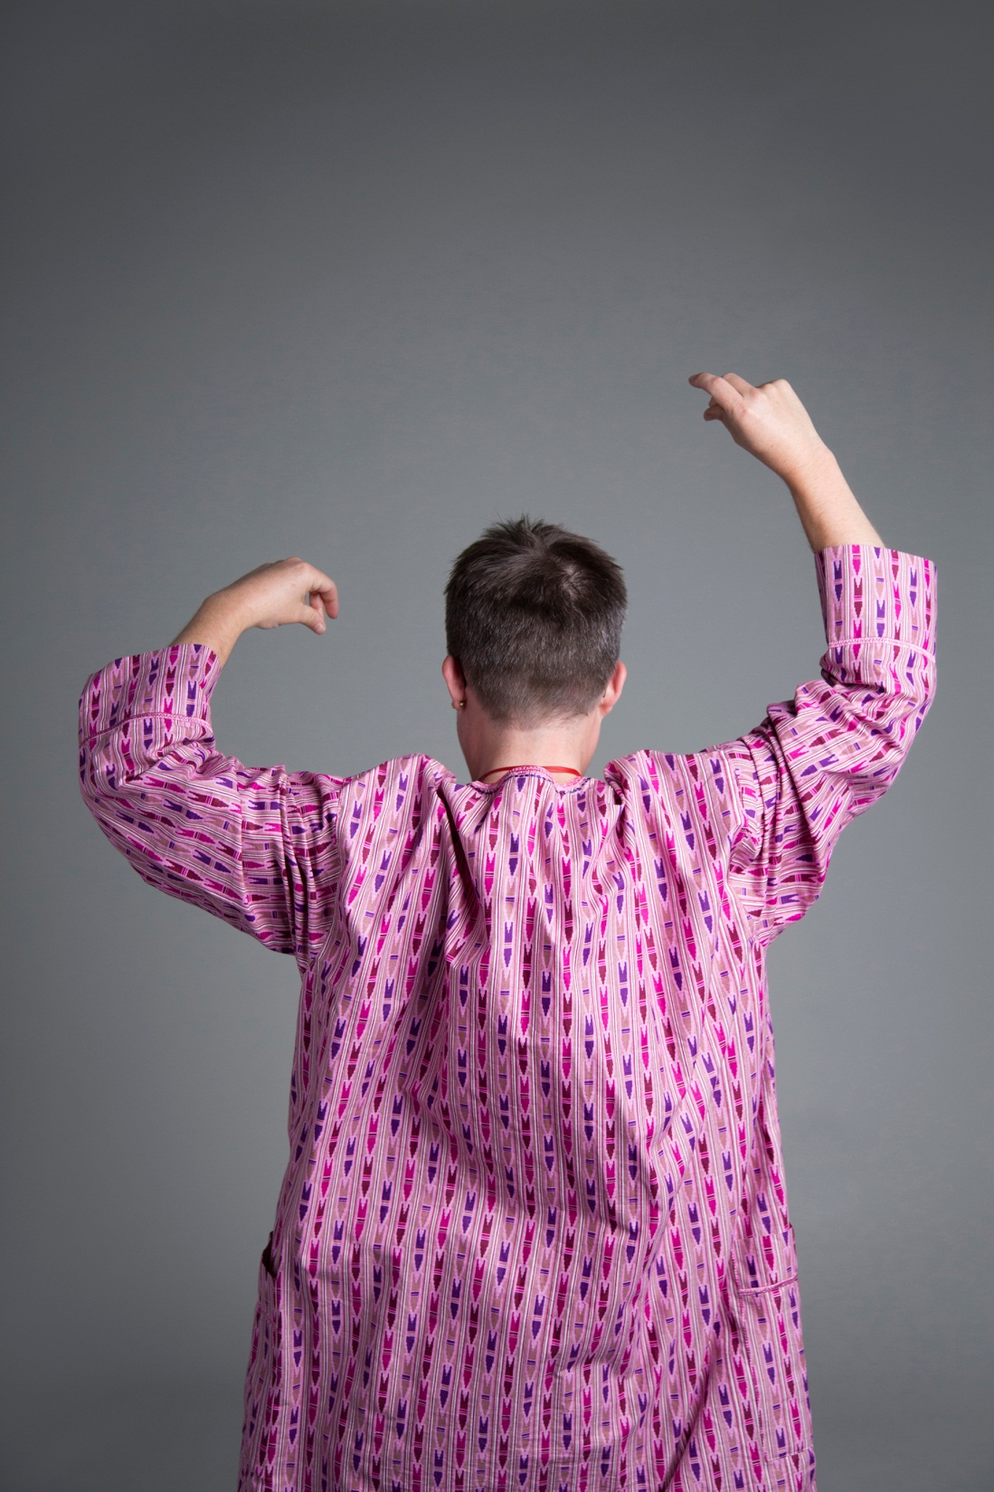
Robin

Slide 19
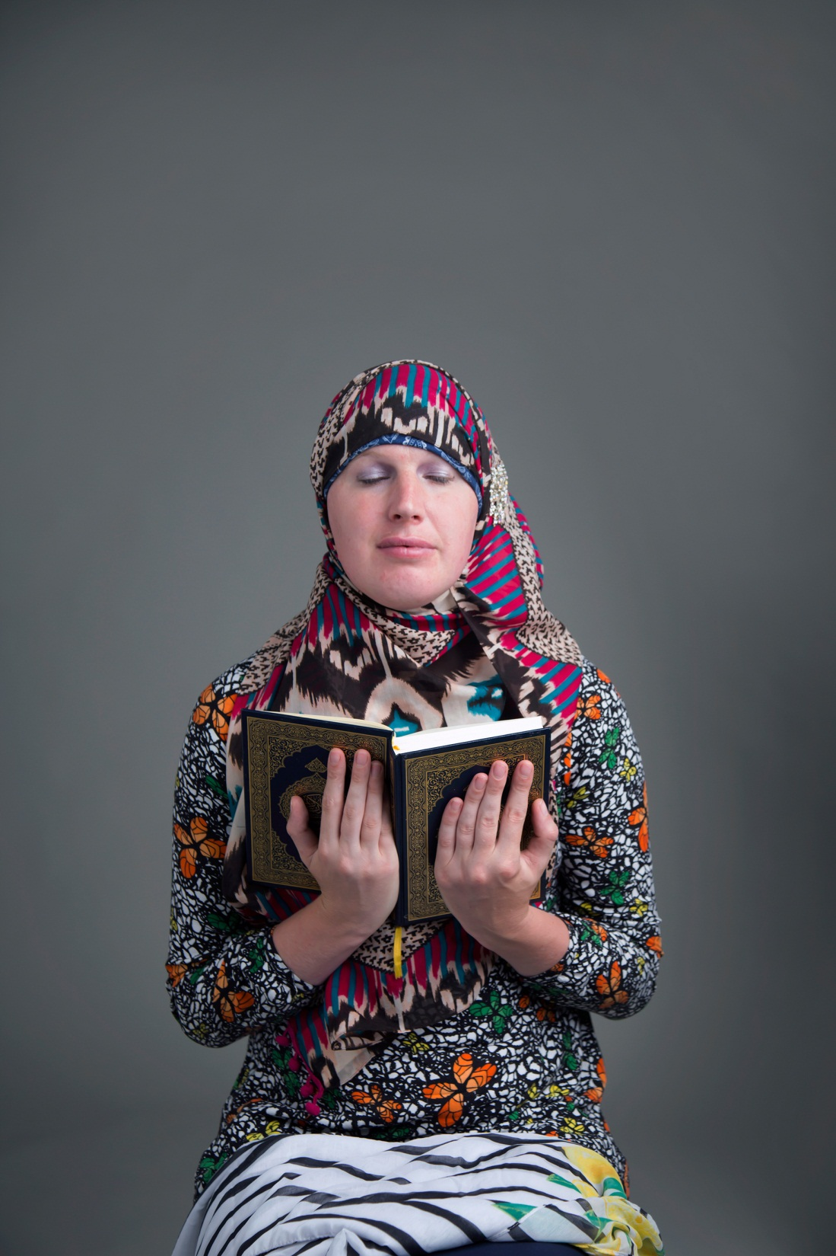
Layla

Slide 20
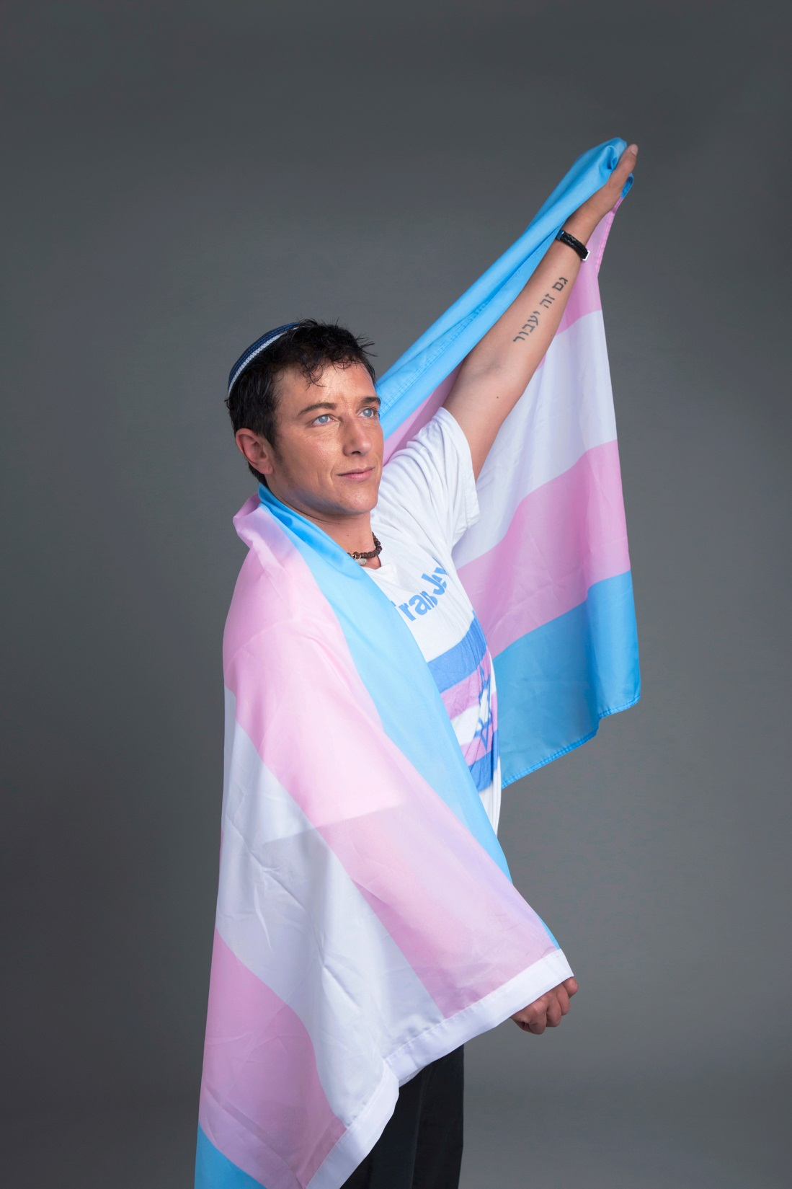
Surat-Shaan

